Slide 1

Pitch deck

Slide 2
Selected Paper
Visual narratives to edutain against misleading visualizations in healthcare
LEARN: A Story-Driven Layout-to-Image Generation Framework for STEM Instruction

Slide 3
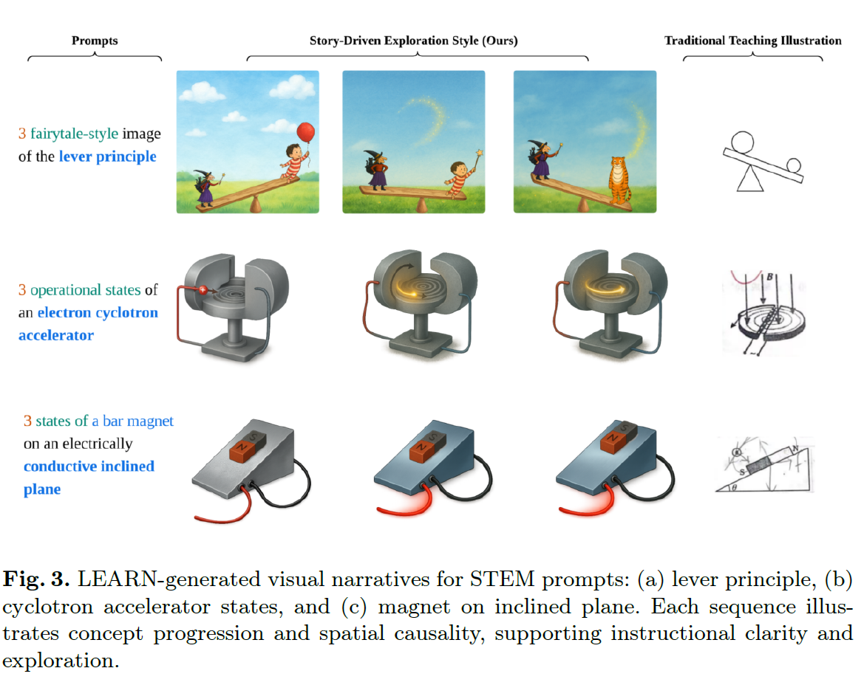
Overview
Title: LEARN: A Story-Driven Layout-to-Image Generation Framework for STEM Instruction (2025)
Venue: The International Conference on Neural Information Processing (ICONIP) 2025
Focus: Story-driven visual generation for educational materials using layout-aware diffusion.

Slide 4
Rational
Addresses the lack of narrative coherence and structural control in AI-generated educational images.
Aims to bridge narrative scripts and visual layout generation for STEM learning materials.
Motivated by the need for automatic, scalable creation of instructional visuals with consistent layout and character continuity.

Slide 5
Methods
Pipeline: Text (story/script) → Layout prediction → Layout-to-Image diffusion generation.
Core model: Layout-conditioned diffusion trained with CLIP-based layout embeddings for semantic-spatial alignment.
Introduces a Story Consistency Module to maintain cross-frame coherence (characters, backgrounds).
Benchmarks against baseline text-to-image models on layout accuracy and visual consistency.

Slide 6
Results
Achieves higher layout fidelity (IoU, region-level matching) and narrative coherence compared to baselines.
Produces visually coherent instructional sequences (multi-panel or step-wise visuals).
Improves user-rated clarity and story alignment in educational image sequences.

Slide 7
challenges
Relies on curated layout-script pairs → limited generalization to open-domain or clinical data.
Quality still varies for complex scenes or long story sequences.
Requires manual or structured input scripts, limiting automation.
Ethical concerns in educational accuracy and bias in visual representations.

Slide 8
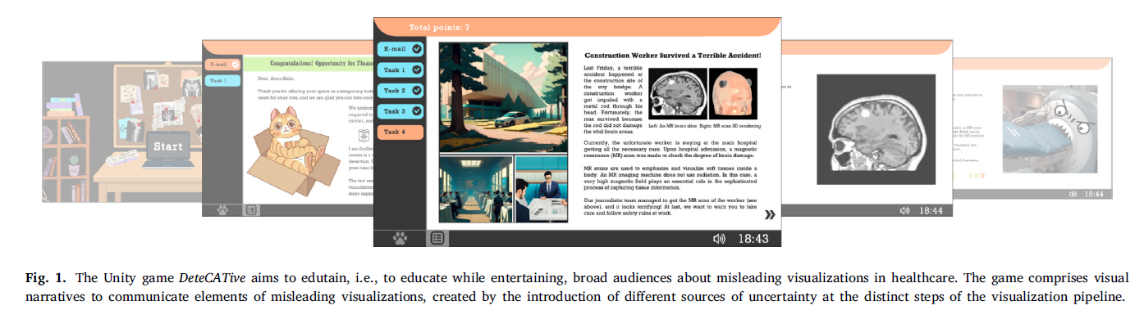
Overview
Title: Visual Narratives to Edutain Against Misleading Visualizations in Healthcare (2024)
Venue: Computers & Graphics
Focus: Using visual storytelling and “edutainment” techniques to help audiences detect and understand misleading health visuals.

Slide 9
Rational
Health graphics can easily mislead the public through scale, framing, or missing context.
Conventional fact-checking rarely reaches non-experts; visual narratives can communicate corrective insight more intuitively.
Goal: design educational yet engaging narrative experiences that improve visual-literacy and critical reasoning in health communication.

Slide 10
Methods
Conducted a design-based study creating eight short interactive or animated visual-narrative scenarios (“edutainment games”).
Each scenario illustrated a common visualization fallacy (e.g., truncated axes, cherry-picked data, deceptive color maps).
Evaluated through user experiments measuring comprehension, enjoyment, and recall.
Mixed-methods analysis combining survey data and qualitative feedback.

Slide 11
Results
Participants exposed to the narrative versions showed higher engagement and better recognition of misleading elements.
Reported stronger recall of key lessons and improved ability to critique unseen visualizations.
Demonstrated potential of narrative visualization as an educational and persuasive tool for public-health literacy.

Slide 12
Challenges
Small sample size and limited demographic diversity.
Scenarios focused on stylized examples → uncertain transfer to real-world infographics.
Difficult to scale manual narrative design for many health topics.
No long-term retention or behavior-change evaluation yet.

Slide 13
Questions
Are we going to use the same data with the categories?
Yes
What are the categories for (what we are going to tell)?
Who care (or need to know) about the categories (the audience, who use)?
Why visual application needed (the gaps in the field and why visual helps)?
No
What problem exist in the domain (the known problem)?
What is the gap or difficulty in current setting (who use and why need)?
Any data support the problem and have the information we need (what we need)?
We know tools are there, but what is the problem we want to solve?

Slide 14
Thank you
Yi-Chun (Rimi) Chen
10/17/2025

